Slide 1

Website Programming

Slide 2
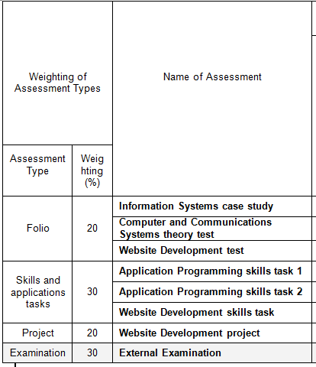
your assessment process so far…
10% done
10% done

Slide 3
week 1 | week 2 | week 3 | week 4 | week 5 | week 6 | week 7 | week 8 | week 9 | week 10
theory user guide | theory user guide | theory user guide | theory user guide | theory user guide | theory user guide | project | project theory test | project | project skills test
project 20%
theory test 10%
skills test 10%
what is the user guide?
the weekly, personal, practical folio (weekly exercise)
it is used to practice, study and as cheat sheet for skills tasks

Slide 4
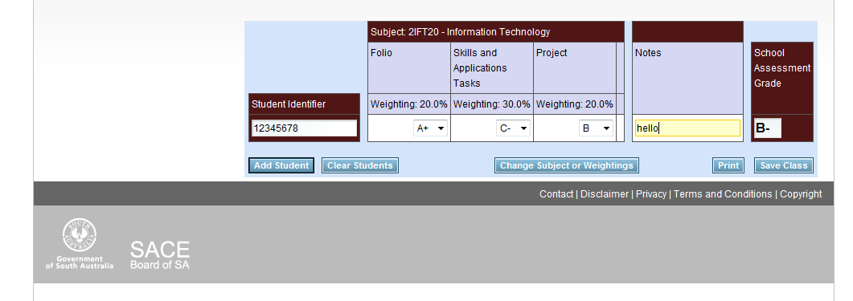
SABSA school assessment calculator
there

Slide 5
Things to cover:
HTML/HTML5
DOM
VALIDATION
XML/XHTML
AJAX concept
CSS
JAVASCRIPT
FORMS
URL ADDRESS
DOMAIN NAMES
PROTOCOLS
INTERNET
SERVERS
ISP
SOCIAL RESPONSIBILITIES
other issues...

